Slide 1
RISC and CISC
Reduced Instruction Set Architecture
&
Complex Instruction Set Architecture

Slide 2
RISC Processor
Reduced Instruction Set Computer
Key features or major characteristics :
It is a type of microprocessor
It has a limited number of instructions.
It has a simple instructions (fixed length and easy to decode).
It can execute the instructions very fast
Large number of general purpose registers
It has ability to execute one instruction per dock cycle.
Hardwired rather than microprogrammed controlled.

Slide 3
RISC Processor
Register-to-register operations
Only simple load and store operations for memory access.
Each operand is brought into a processor register with a load instruction.
Only a few addressing modes (such as immediate operands and relative mode)
All operations or computations are done among the data stored in processor registers.
Results are transferred to memory by means of store instructions.
Less Data types.
Code size is large

Slide 4
CISC Processor
Complex Instruction Set Architecture
The design of an instruction set for a computer must take into consideration not only machine language constructs, but also the requirements imposed on the use of high-level programming languages.
The translation from high-level to machine language programs is done by means of a compiler program.
One reason for the trend to provide a complex instruction set is the desire to simplify the compilation and improve the overall computer performance.
The task of a compiler is to generate a sequence of machine instructions for each high-level language statement.

Slide 5
CISC Processor
Complex Instruction Set Architecture
Key features or major characteristics :
A large number of instructions-typically from 100 to 250 instructions
Some instructions that perform specialized tasks and are used infrequently.
A large variety of addressing modes-typically from 5 to 20 different modes (Complex Addressing Modes)
Variable-length instruction formats
Direct manipulation of operands residing in memory
Instructions that manipulate operands in memory
More Data types.
Code size is small

Slide 6
RISC Processor
A large number of registers is useful for storing intermediate results.
The advantage of register storage is that registers can transfer information to other registers much faster than the transfer of information to and from memory.
Thus register-to-memory operations can be minimized by keeping the most frequent accessed operands in registers.
The use of overlapped register windows when transferring program control after a procedure call can improve the performance for RISC architecture.

Slide 7
RISC Overlapped Register Windows
Procedure call and return occurs quite often in high-level programming languages.
When translated into machine language, a procedure call produces a sequence of instructions that save register values, pass parameters needed for the procedure, and then calls a subroutine to execute the body of the procedure.
After a procedure return, the program restores the old register values, passes results to the calling program, and returns from the subroutine.
Saving and restoring registers and passing of parameters and results involve time consuming operations.

Slide 8
RISC Overlapped Register Windows
Some computers provide multiple-register banks, and each procedure is allocated its own bank of registers.
This eliminates the need for saving and restoring register values.
Some computers use the memory stack to store the parameters that are needed by the procedure
But this requires a memory access every time the stack is accessed.
RISC processors use of overlapped register windows to provide the passing of parameters and avoid the need for saving and restoring register values.

Slide 9
RISC Overlapped Register Windows
Each procedure call results in the allocation of a new window consisting of a set of registers.
Each procedure call activates a new register window by incrementing a pointer.
While the return statement decrements the pointer and causes the activation of the previous window.
Windows for adjacent procedures have overlapping registers that are shared to provide the passing of parameters and results.

Slide 10
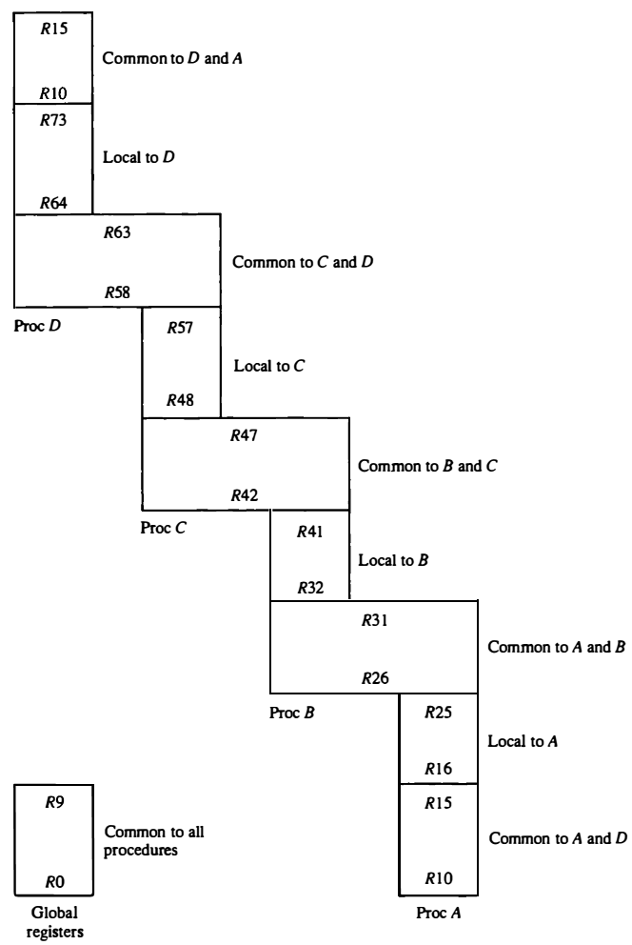
RISC Overlapped Register Windows
The overlapped register windows system has a total of 74 registers.
Registers RO through R9 are global registers that hold parameters shared by all procedures.
The other 64 registers are divided into four windows to accommodate procedures A, B, C, and D.
Each register window consists of 10 local registers and two sets of six registers common to adjacent windows.
Fig: Overlapped register windows

Slide 11
RISC Overlapped Register Windows
Local registers are used for local variables.
Common registers are used for exchange of parameters and results between adjacent procedures.
The common overlapped registers permit parameters to be passed without the actual movement of data.
Only one register window is activated at any given time with a pointer indicating the active window.
Fig: Overlapped register windows

Slide 12
RISC Overlapped Register Windows
Each procedure call activates a new register window by incrementing the pointer.
The high registers of the calling procedure overlap the low registers of the called procedure
Therefore the parameters automatically transfer from calling to called procedure.
Fig: Overlapped register windows

Slide 13
RISC Overlapped Register Windows
For example, the procedure A calls procedure B.
Registers R26 through R31 are common to both procedures.
Therefore, procedure A stores the parameters for procedure B in these registers.
Procedure B uses local registers R32 through R41 for local variable storage.
Fig: Overlapped register windows

Slide 14
RISC Overlapped Register Windows
If procedure B calls procedure C, it will pass the parameters through registers R42 through R47.
When procedure B is ready to return at the end of its computation.
The program stores results of the computation in registers R26 through R31 and transfers back to the register window of procedure A.
Fig: Overlapped register windows

Slide 15
RISC Overlapped Register Windows
Note that registers R1O through R 15 are common to procedures A and D because the four windows have a circular organization with A being adjacent to D.
Other fixed-size register window schemes are possible, and each may differ in the size of the register window and the size of the total register file.
Fig: Overlapped register windows

Slide 16
RISC Overlapped Register Windows
Number of global registers = G
Number of local registers in each window = L
Number of registers common to two windows = C
Number of windows = W
The number of registers available for each window is calculated as follows:
window size = L + 2C + G
The total number of registers needed in the processor is
register file = (L + C)W + G
In the running example, we have G = 10, L = 10, C = 6, and W = 4.
The window size is 10 + 12 + 10 = 32 registers
register file consists of (10 + 6) x 4 + 10 = 74 registers.

